Slide 1

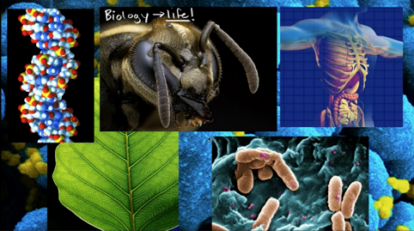
CB-102: Biology (for Engineers)
Course Instructor
Dr. Mahendra Ram
Department of Chemical and Biochemical Engineering
Email: mahendra.cbe@iitp.ac.in
INDIAN INSTITUTE OF TECHNOLOGY PATNA

Slide 2
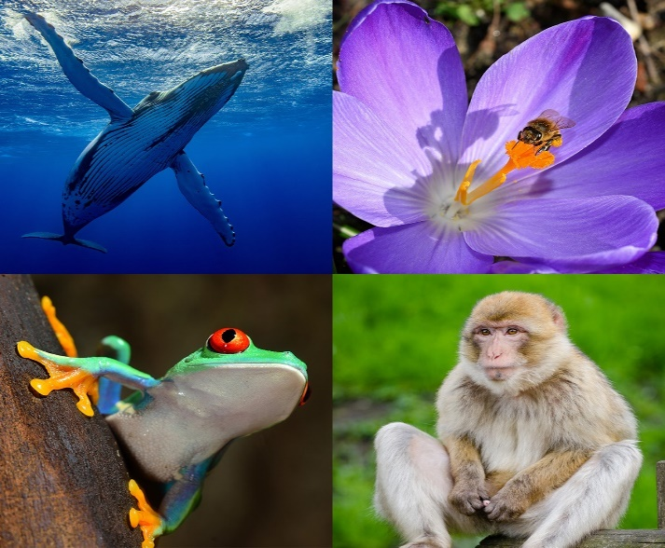
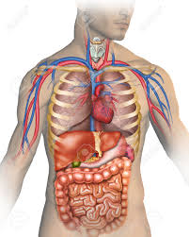
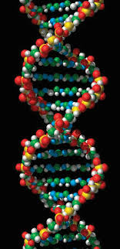
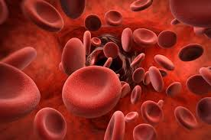
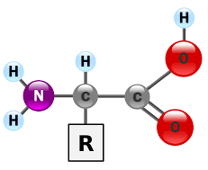
Course Contents
Introduction to biology
Cell theory: cell structure, cell cycle and growth; cell division
Cell construction: biomolecules (proteins, carbohydrates, nucleic acids, lipids, etc.)
Genetics: nucleic acids, chromatin, DNA structure, replication, transcription & translation
Enzymes and metabolism
Blood anatomy and physiology
Common infections and diseases

Slide 3
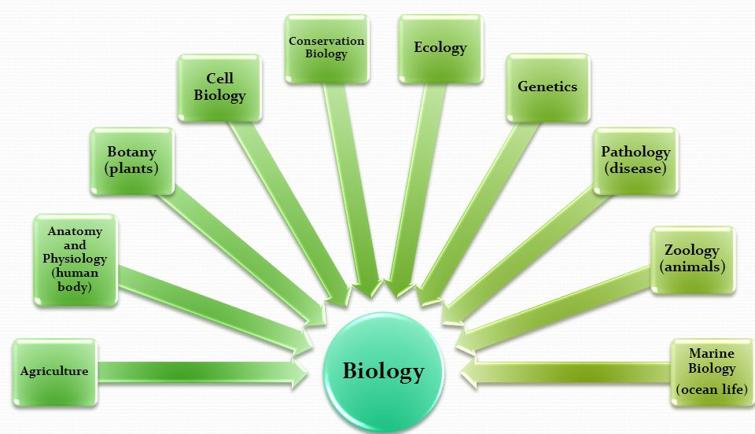
Biology
Biology (Greek word, bios = life, logos = knowledge) is the natural science that studies life and living organisms, including their physical structure, chemical processes, molecular interactions, physiological mechanisms, development and evolution.
~ 8.7 million species are present on earth (including ocean flora and fauna).
What defines a life and a living system?
Metabolism and energy production
Reproduction, growth and development
Excretion
Respiration
Sensitivity to environment and self adaptation (evolution)
Organization

Slide 4
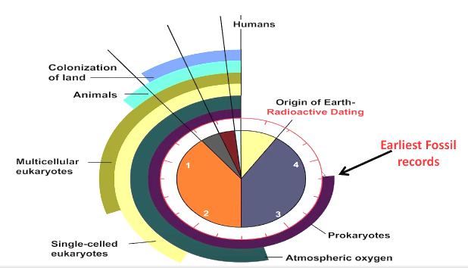
Time scale (billion years) and origin of life
Development of Life
Chemical Evolution: Geological elements (C, N, O, H, P, S, etc.) to complex organic polymers.
Acquisition of Replicative Ability: Transition from lifeless chemically interacting entities to self replicating systems.
Biological Evolution: eukaryotes, multi-cellular organisms, plant and animals, metabolic evolution.

Slide 5
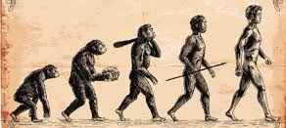
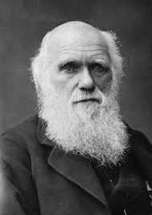
Evolution of life
Darwin’s theory of evolution by natural selection.
All species of organisms arise and develop through the natural selection of small, inherited variations that increase the individual's ability to compete, survive, and reproduce: Survival of the fittest (term used by Herbert Spencer in his book ‘Principles of Biology’).
Charles Darwin (1809-1882)
British Biologist and Geologist
Observations:
Individuals in population exhibit variable traits: Variations
Many traits are heritable
Species adapt to their environment
Limited resources
Competition for survival

Slide 6
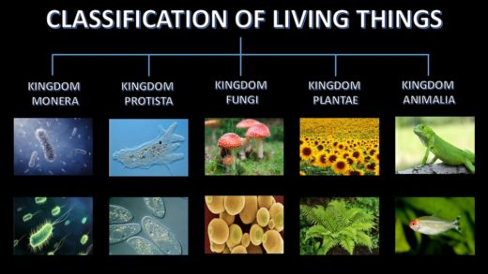
R.H. Whittaker’s
Domain
Kingdom
Phylum
Class
Order
Family
Every living being on earth is referred through its binomial nomenclature which consist of its genus and species name. Ex. Bacillus subtillis (bacteria, used in antibiotic production), Homo sapiens (wise man).
Genus
Species

Slide 7



Slide 8



Slide 9
Why Biology to Engineers ?
To find solutions to challenges (birds to fly, leaf to super-hydrophobic materials, photosynthesis to solar cells, fish to streamlined bodies, etc.)
Search for sustainability and green processes (life forms have evolved and co-existed in harmony with their surroundings for million of years, if we need solutions, find it how biology does it: biomimicry)
Wellness (health: physical and mental): better understanding of cell, its process and systems as a whole.

Slide 10
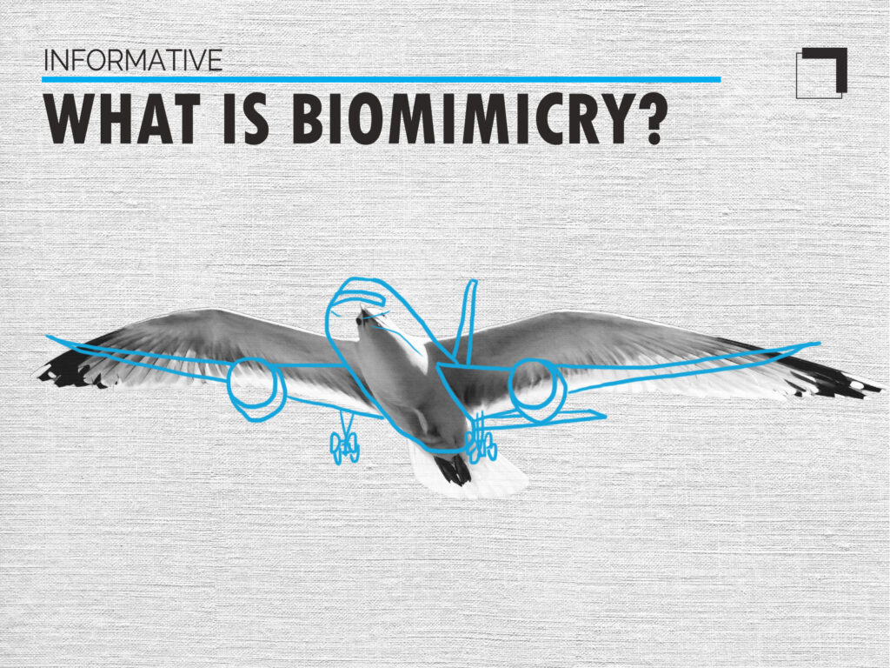

Slide 11
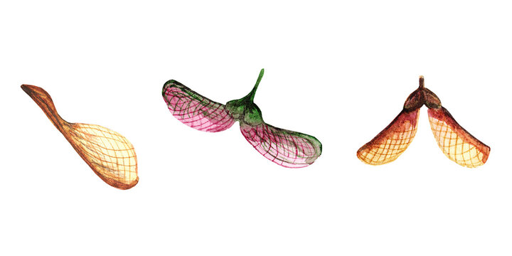
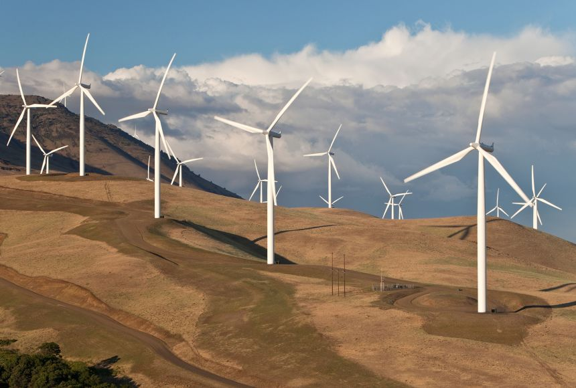

Slide 12
Biology based engineering and technology
Bioengineering
Biotechnology
Biochemical engineering
Biomolecular Engineering
Biomechanics
Computational biology
Environmental engineering
Bio-energy
Microbiology
Biochemistry
Synthetic biology
Genetic engineering
Biophysics
Biomedical engineering
Bioinformatics

Slide 13
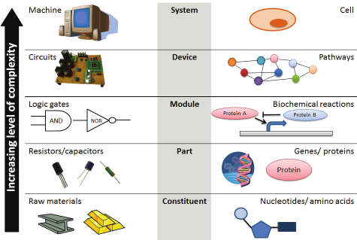
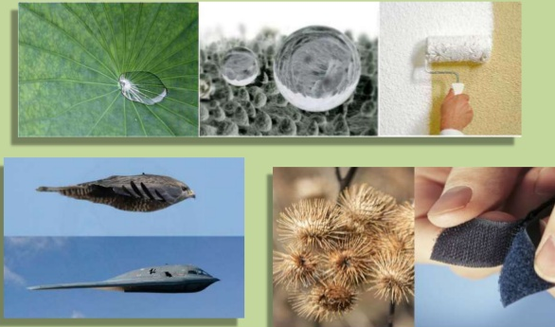
Applications of Biology in Engineering
Mechanical Engineering (biofuels, biofluidics, biomechanics, biosensors, biomedical devices and instrumentation, tissue mechanics, membrane transport)
Computer Science and Engineering (AI, robotics, machine learning, bioinformatics and computational biology)
Chemical Engineering (blood rheology, transport of energy and species, bioreactor design, enzyme engineering, biogas, membranes)
Civil Engineering (environmental biology, ecology, earth science, health, safety and hazards)
Electrical Engineering (neuroscience, bioimaging, biosensors, nerve system, diagnostic equipment, heart monitor, lab on a chip)
Material Science and Engineering (biomaterials, micro- and nanostructures, soft materials)

Slide 14
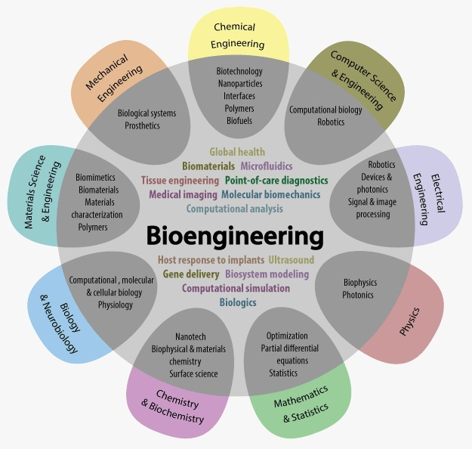
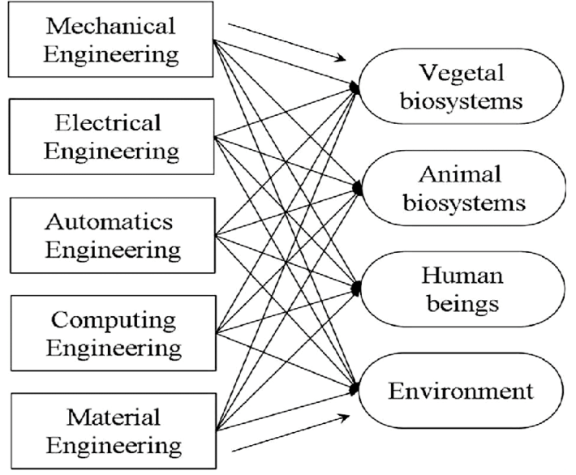
Interdisciplinary nature of bio-based engineering

Slide 15
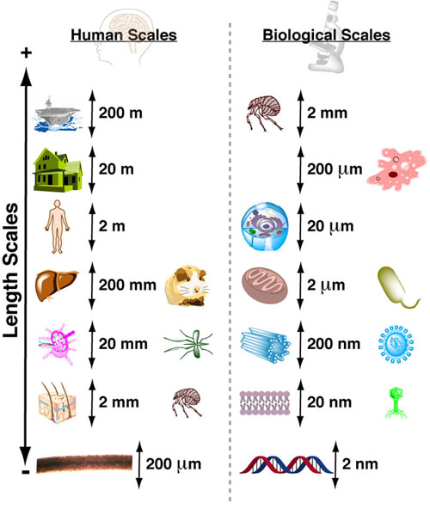
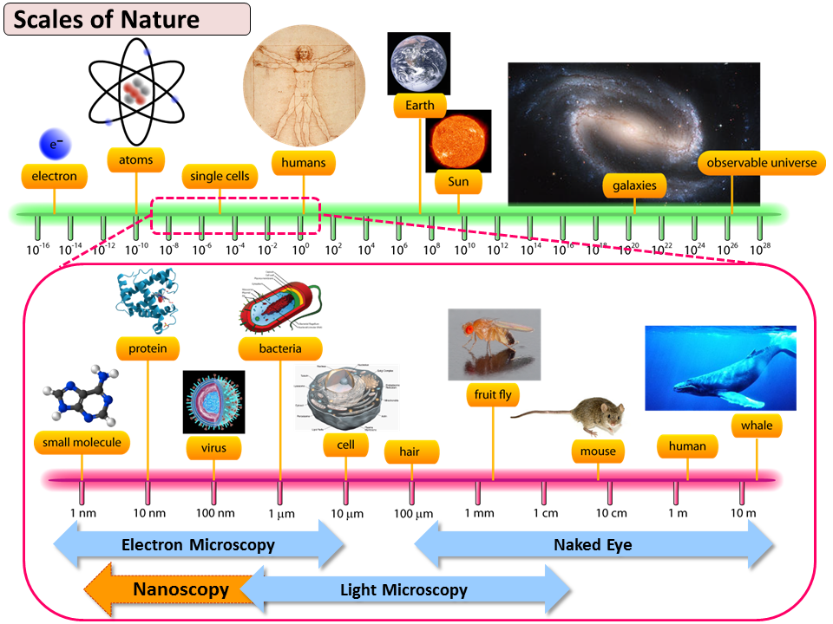
Length Scales of Life

Slide 16
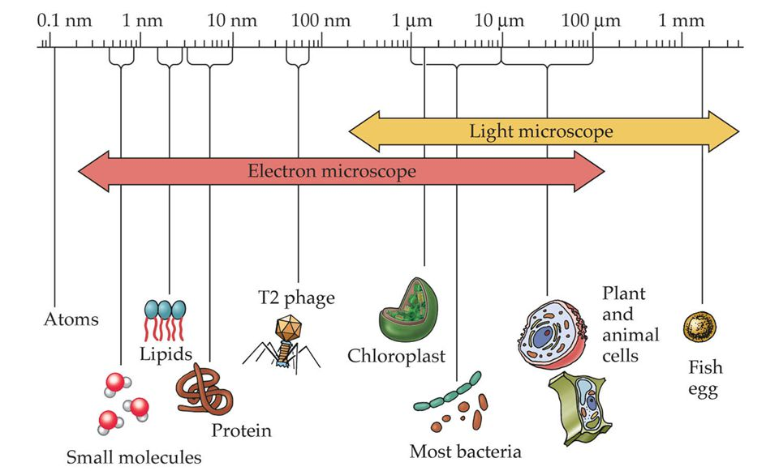
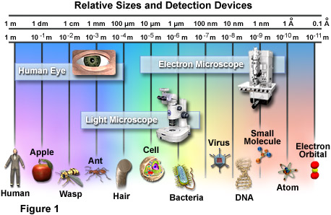
Length Scales of Life

Slide 17
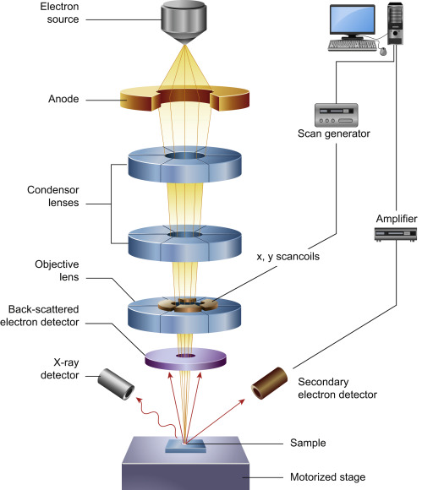
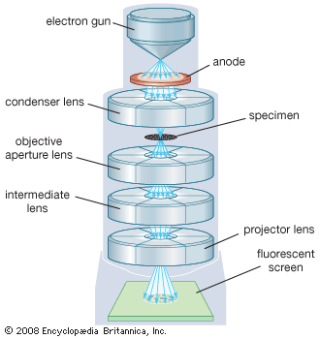
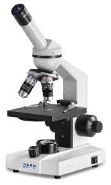
Visualization of cells and microorganisms
Scanning Electron Microscope
(SEM)
Transmission Electron Microscope
(TEM)
Transmitted Light Microscope
(TLM)

Slide 18
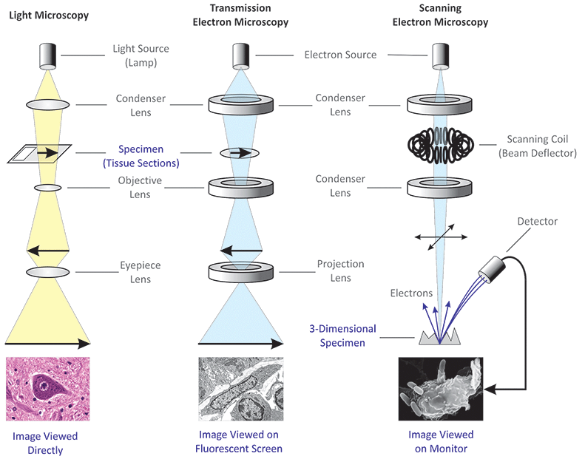

Slide 19
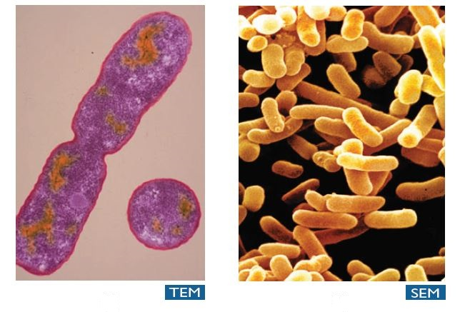
Scanning Electron Microscope
(SEM)
Transmission Electron Microscope
(TEM)
Transmitted Light Microscope
(TLM)
Produces images of a sample by scanning the surface with a focused beam of electrons
A beam of electrons is transmitted through a specimen to form an image
Light is transmitted from a source on the opposite side of the specimen. the image of the specimen is enlarged through objective lens.

Slide 20
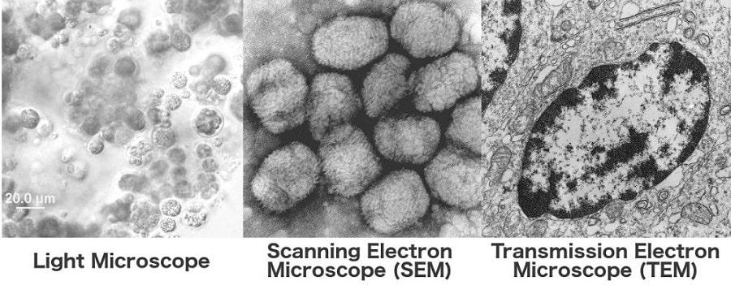

Slide 21
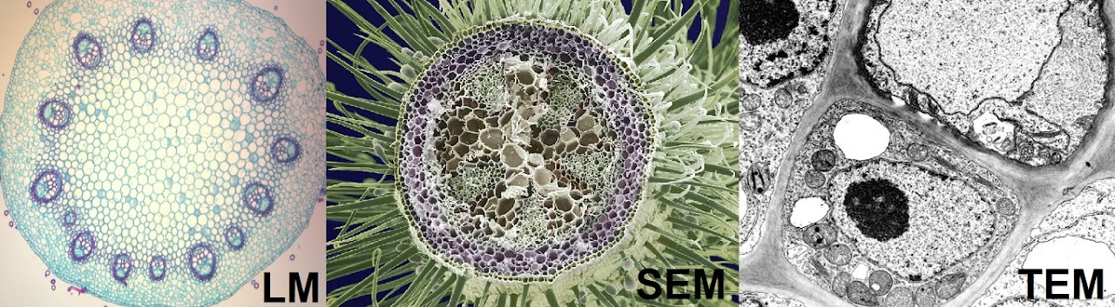

Slide 22
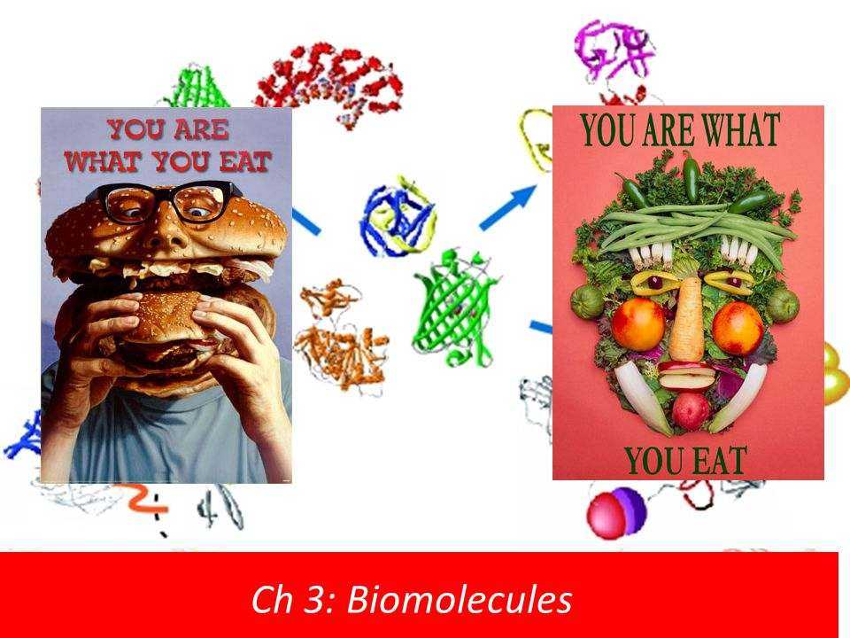
Biological macromolecules

Slide 23
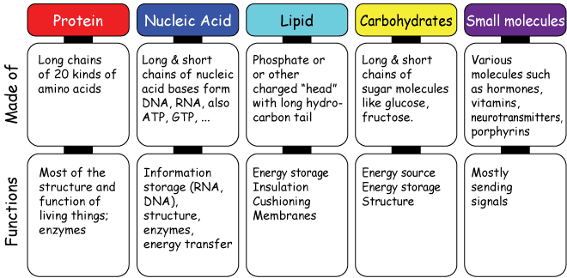
Biological molecules

Slide 24
Biomolecules
Biomolecules
Carbohydrates
(Sugars, starch)
Lipids
(fats, oil, wax, steroid)
Proteins
(amino acids)
Nucleic Acids
(DNA, RNA)
These are high molecular wt. polymers (> 10⁴ Da) of small biomolecules (monomers) which are essential for life and are present in a living organism or produced by them.
Derived from hydrocarbons (contain C, H atoms essentially).

Slide 25
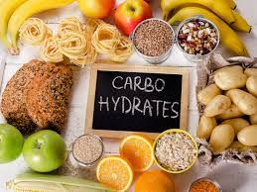
1. Carbohydrates
Most abundant biomolecule in nature.
Hydrates of carbon or C_{m}(H₂O)_{n}.
Organic substances having C, H and O where H and O are in 2:1 ratio as found in H₂O.
Source of energy, storage of energy (short term) in form of glycogen.
Example: glucose, fructose, galactose, ribose, sucrose, starch, cellulose, etc.
< 1% of body weight.

Slide 26
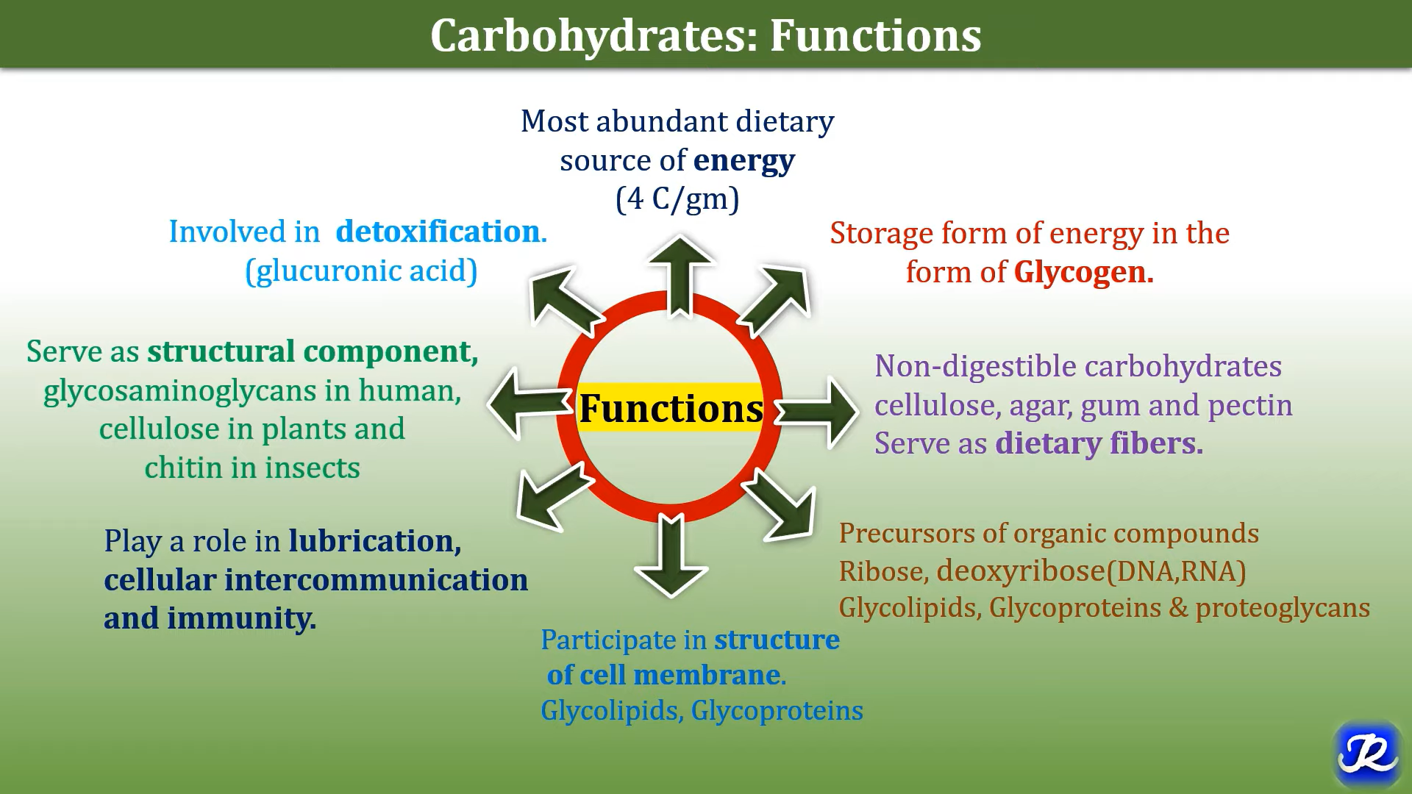

Slide 27
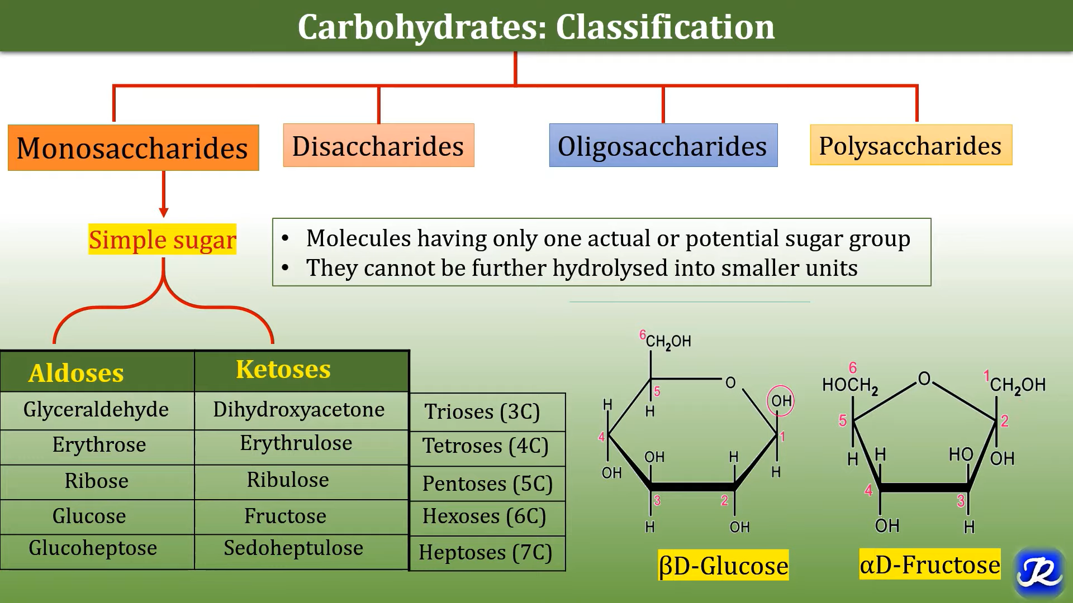

Slide 28
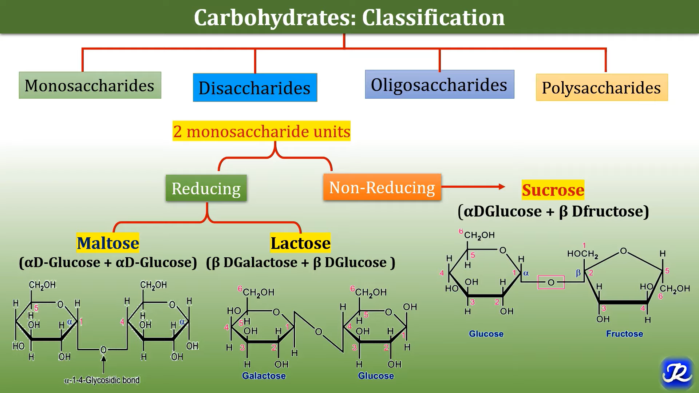

Slide 29
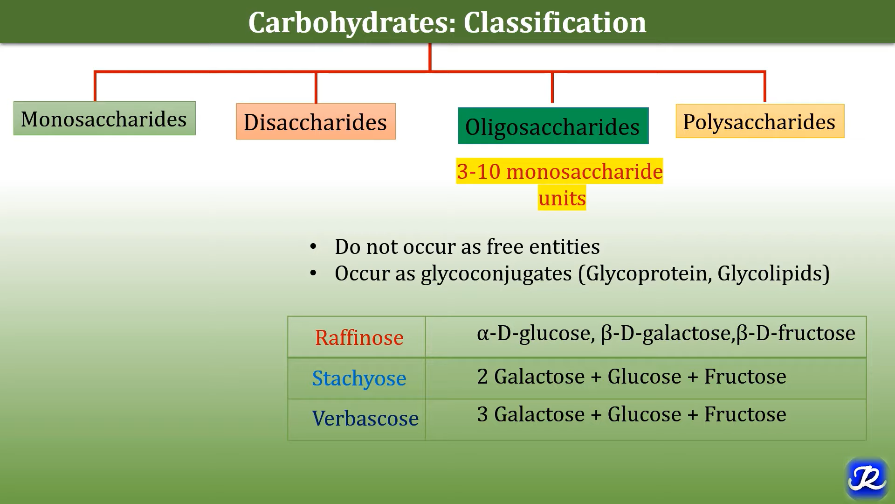

Slide 30
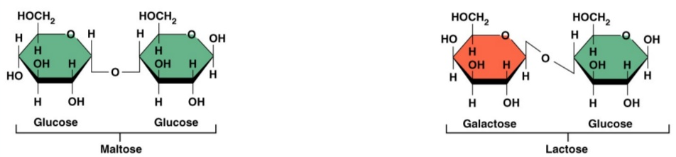
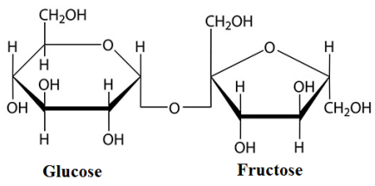
Oligosaccharides
Polymers of 2-10 monosaccharides, sweet and water soluble.
Example: disaccharides (sucrose or cane sugar from glucose and fructose molecules, lactose in milk from glucose and galactose molecules, maltose or malt sugar from 2 glucose molecules), trisaccharides (raffinose).
Glucose and fructose are linked through glycosidic bond to form sucrose and one H₂O molecule is removed through condensation.
Sucrose (C₁₂H₂₂O₁₁)

Slide 31
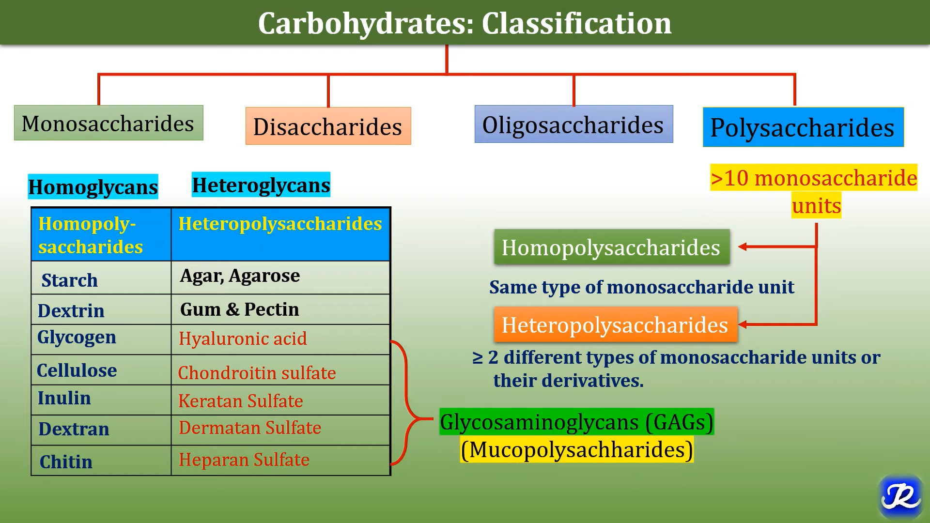

Slide 32
Polysaccharides
Repeating units of monosaccharides (also known as glycans).
Storage and structural components, insoluble in water, not sweet in taste, carbohydrate reserve in plants.
Storage polysaccharide: starch (linear homopolymer of α-glucose, dietary source for animals, cereals, vegetables, etc., derived from plants only), glycogen (carbohydrate reserve in animals, found in liver, muscle, brain, it is a branched α-glucose polymer, derived from animals only), inulin (polymer of fructose, found in garlic, onion, not metabolized in body).

Slide 33
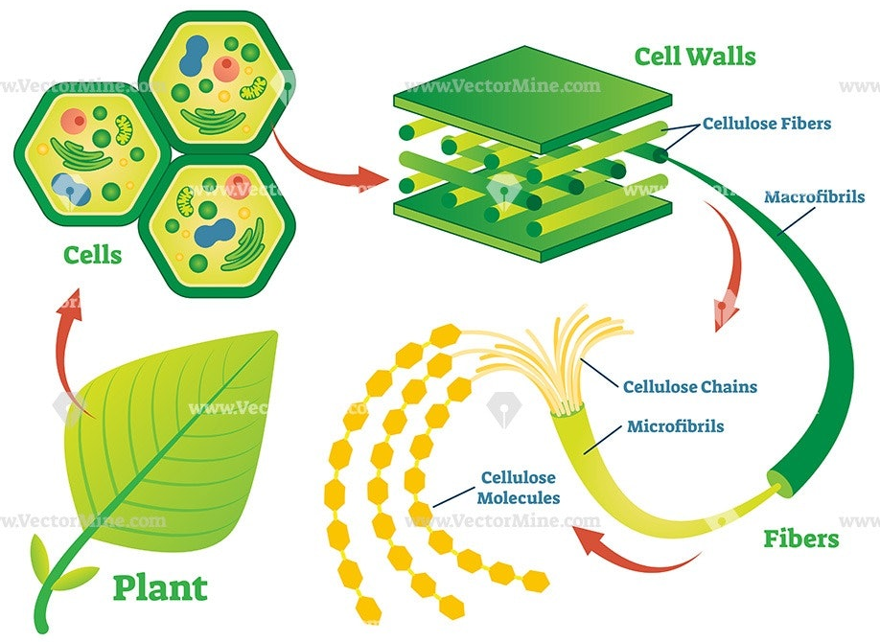
Polysaccharides (contd.)
Structural polysaccharide: cellulose (homopolymer of β-glucose, constituent of plant and bacteria cell wall, present in plants only, cannot be digested).
Cellulose

Slide 34
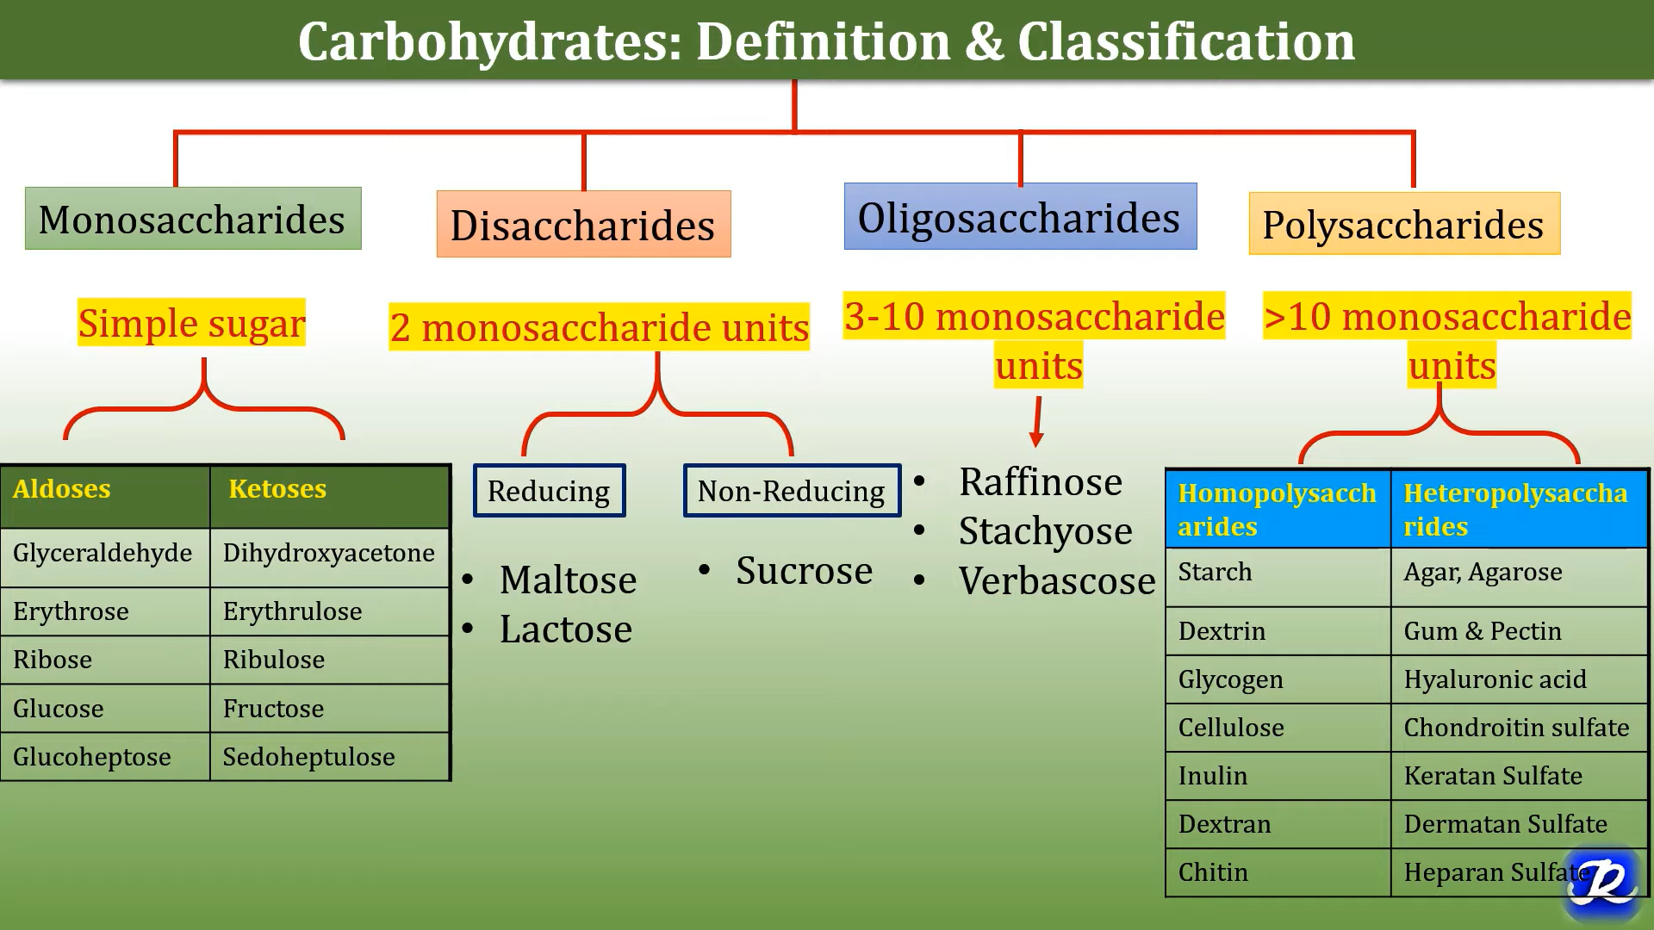

Slide 35
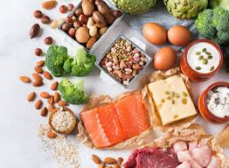
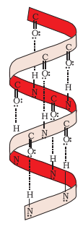
2. Proteins
Most abundant biomolecule in living system (antibody, harmones, enzymes, pigments, toxins).
Polymers of long chain of α-amino acids joined together by a peptide bond (-CO-NH-) through dehydration synthesis,
contain C, H, O and N.
Required for structure (building block), growth, function, maintenance of cells, defense against germs and infections.
Four levels of protein structure based on folding, coiling and interaction between amino acid molecules through hydrogen and ionic bonds: primary, secondary, tertiary and quaternary (insulin, hemoglobin, collagen).
Fuel source (~ 4 kcal/g), DNA makes RNA makes protein.
α-helix structure of protein

Slide 36
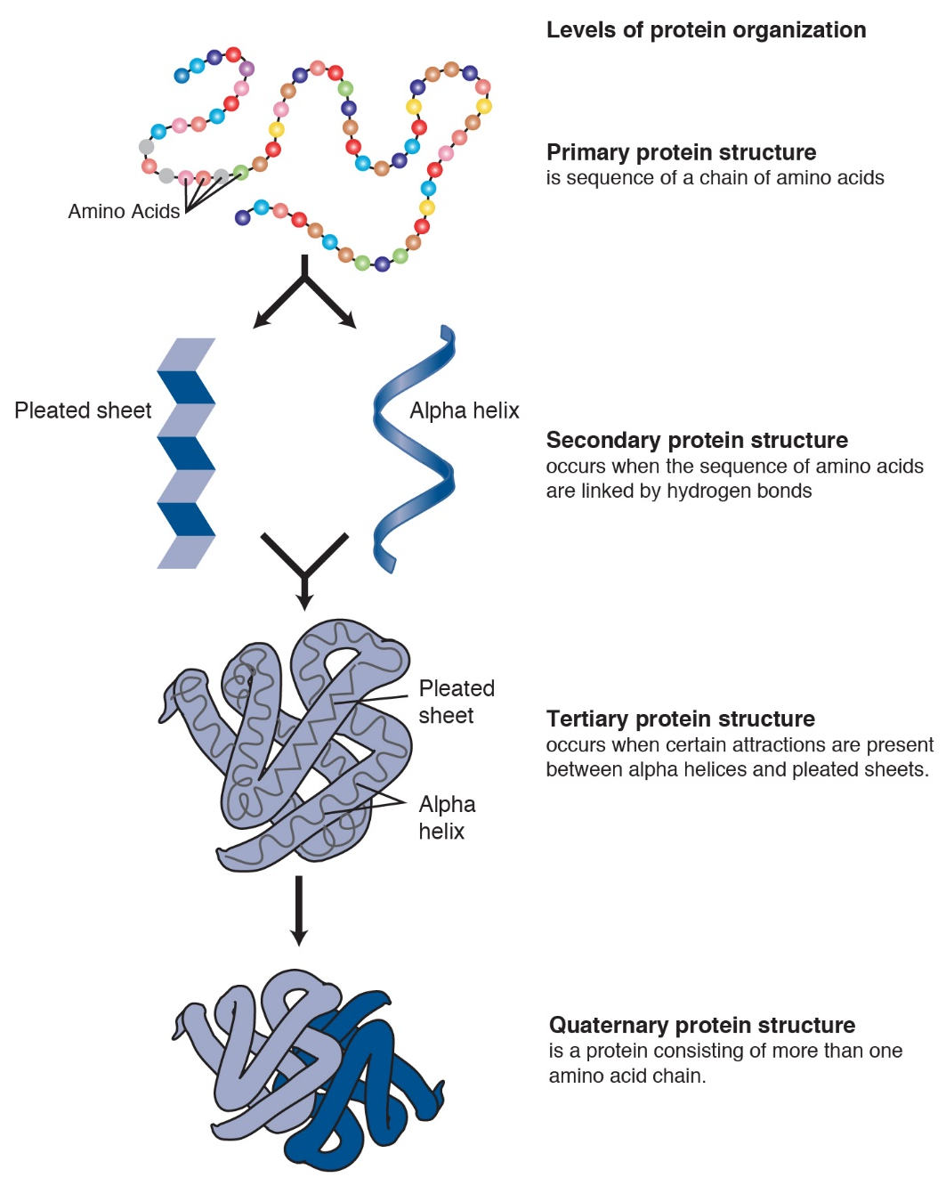
Proteins (contd.)
Protein are found in a biological system with a unique 3D structure and biological activity.
When a protein is subjected to physical or chemical change like change in temperature or pH, the hydrogen bonds are disturbed. Due to this, the helix get uncoiled and protein loses its biological activity. This is called denaturation of proteins.
During denaturation secondary and tertiary structures are destroyed but primary structure remains intact. The coagulation of egg white on boiling is a common example of denaturation.
Two types: fibrous (keratin, collagen, etc.) and globular (hemoglobin, insulin, etc.) proteins

Slide 37
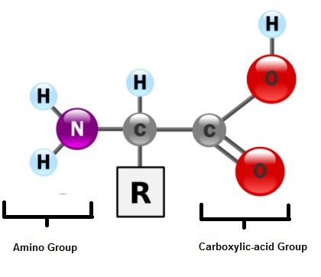
Amino acids
All amino acids have an amino group (-NH₂, basic),
a carboxyl group (-COOH, acidic) and a variable side
chain (-R) bonded to α C-atom.
Two amino acids are connected by peptide bond.
If more than 50 amino acids are joined: polypeptides
Based on different -R groups, there are 20 types of amino acids out of which 9 are essential (cannot be synthesized by body to match with the demand, thus required in diet).

Slide 38
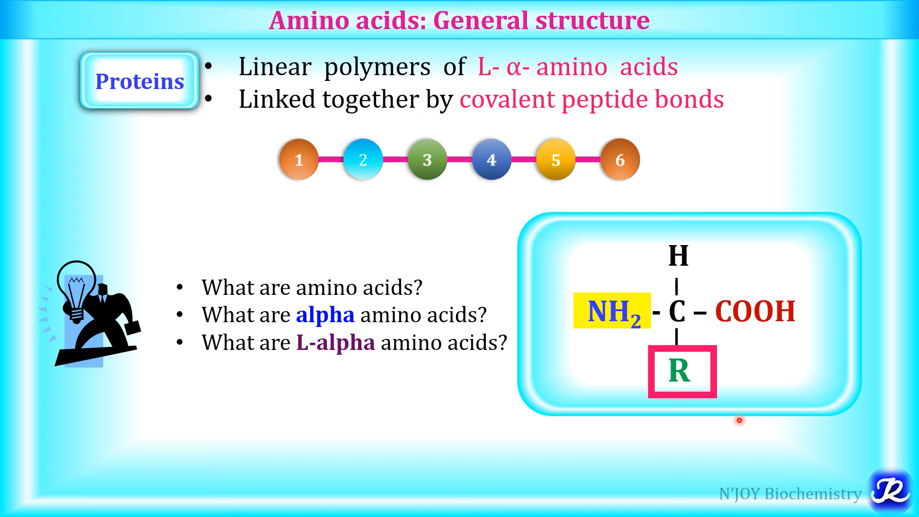

Slide 39
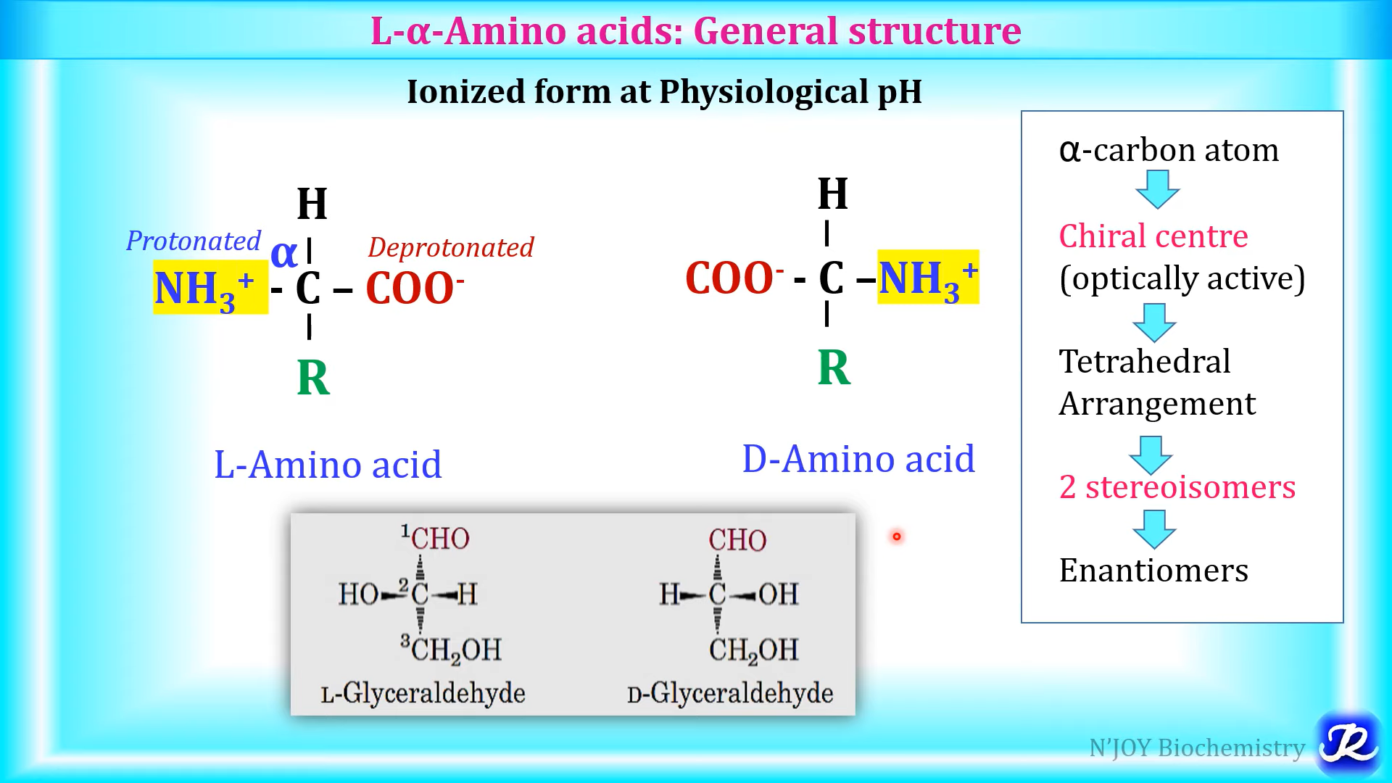

Slide 40
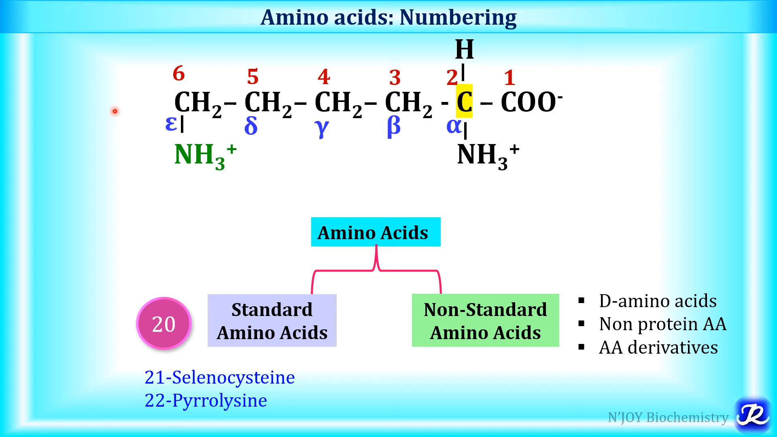

Slide 41
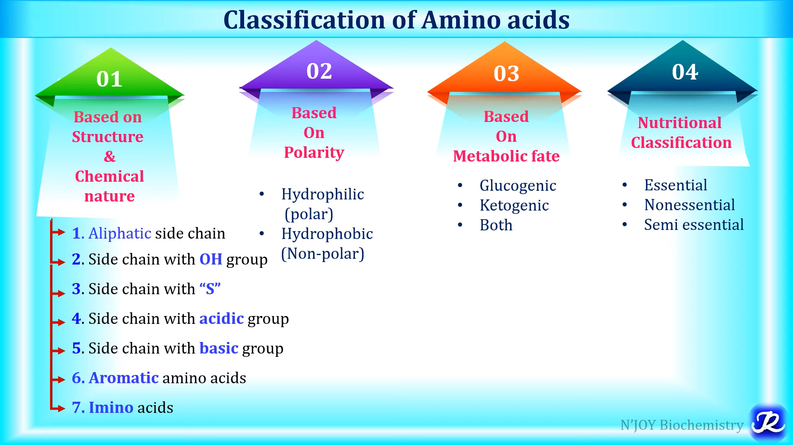

Slide 42
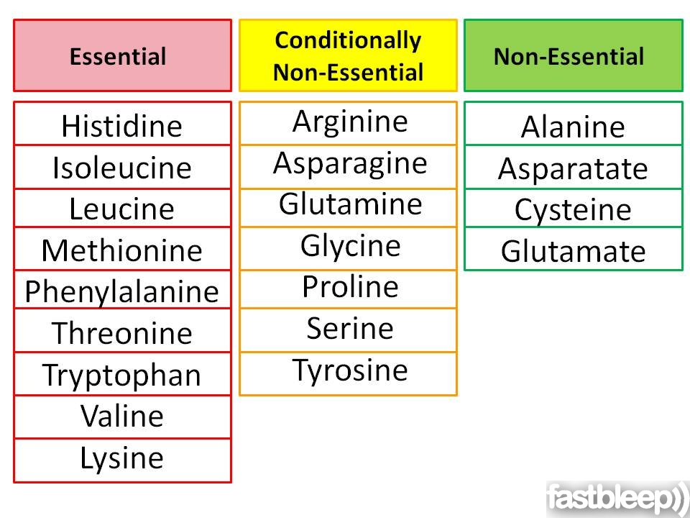
Amino acids (contd.)
α carbon
Amino acids can be classified as acidic, basic or neutral depending on number of amino and carboxyl group.
These are colorless, crystalline solids and water soluble.

Slide 43


3. Lipids
These are macromolecules made of fatty acid and glycerol (alcohol) monomers (or esters of fatty acids).
Main constituent of cell membrane as phospholipids and glycolipids.
Present in vegetable/animal fats and oils, wax,
cholesterol, steroids, etc.
Long term energy
storage, energy source,
cell structure, provides
insulation and protection,
helps in digestion,
precursors of hormones.
Insoluble in water.
1g of a lipid contains twice as much
as chemical energy as 1g
of carbohydrate.

Slide 44

Lipids (contd.)
Complex ring type structures, fat-like properties but do not have fatty acids (Cholesterol)
Triglycerides
Simple esters of long chain saturated fatty acid and alcohol

Slide 45

Lipids (phospholipids)
Phospholipids: these are amphipathic
(both hydrophilic and hydrophobic)
in nature.
Structure (2 parts): head and tails
Heads: glycerol
Heads are polar in nature and thus
hydrophilic.
Tails: fatty acids (carboxylic acid,
oleic acid, unsaturated fat, omega-6,
lauric acid, etc.)
Tails are non-polar and thus hydrophobic.

Slide 46


Phospholipids (contd.)
Each phospholipid (peanut, egg yolk, soybean) consists of a phosphate head (hydrophilic) linked with 2 fatty acid tails (hydrophobic).
Phospholipids contain C, H, O, P and N (nitrogenous base attached to phosphate group).
In glycolipids, instead of a phosphate group a carbohydrate group is attached.

Slide 47

4. Nucleic acids (DNA and RNA)

Slide 48

Nucleic acids
Nucleic acids (polynucleotides) are:
Biomolecules or biopolymers that store genetic information for cellular growth and reproduction within all forms of life on earth.
Examples: deoxyribonucleic acid (DNA) and ribonucleic acid (RNA).
• These are long chains of monomers called nucleotides.
Nucleotides are linked together by a phosphodiester bond.
In 1869, Friedrich Miescher (Swiss biologist) first discovered
nucleic acid in form of nuclein in pus cells.
Friedrich Miescher
(1844-1895)

Slide 49


Nucleic acids (contd.)
The monomer nucleotide is made of three components:
5-carbon sugar (pentose), a phosphate group and a nitrogenous base
Nucleotide derivatives are used in the formation of ATP (adenosine tri-phosphate) which is a major source of energy in cell.
If phosphate group is not present: nucleoside.
A nucleotide is a nucleoside + phosphate group
(Basic structure of Nucleotide)

Slide 50

Nucleoside

Slide 51

The structure of nucleic acid
A nucleic acid
• contains the elements C, H, O, N, P.
has a free 5′-phosphate group at one
end and a free 3′-OH group at the
other end.
The phosphate group joins 3′C of one sugar to 5′C of the other sugar.
It is read from the free 5′-end using the letters of the bases.
This example reads —A—C—G—T—.

Slide 52

Nucleic acids (contd.)
If the sugar is ribose, the polymer is RNA (ribonucleic acid).
If the sugar is deoxyribose, the polymer is DNA (deoxyribonucleic acid).
The 5-carbon sugar: ribose and deoxyribose

Slide 53

Nucleic acids (contd.)
The nitrogenous bases are
• Pyrimidines (6-member single ring): C, T, U
• Purines (double ring): A and G.
A, G, C, T are present in DNA
A, G, C, U are present in RNA
The arrangement of these bases defines the code for protein synthesis.
The phosphate group:
contains pentavalent
phosphorus atom,
3 hydroxyl group and
one divalent oxygen
atom.

Slide 54

Formation of di-nucleotide

Slide 55

Primary structure of polynucleotide
In nucleic acids, the molecules of nucleotide are linked by a phosphodiester and glycosidic bond.
Phosphodiester is a linkage between a sugar molecule and phosphate group.
Glycosidic bond is formed between sugar (1′ C) and nitrogenous base molecule.

Slide 56


Deoxyribonucleic acid (DNA)
DNA is a material of inheritance.
It has a double helix structure of two polynucleotide chains twisted around each other to form a spiral ladder.
It is found inside the nucleus of a eukaryotic cell where it forms the chromosomes.
In case of prokaryotes, DNA is present in the cytoplasm.
Chromosomes have proteins called histones that bind to DNA.

Slide 57
DNA (contd.)
Each nucleus has 23 chromosome pairs and these chromosomes are formed by DNA molecules.
DNA is found during gene expression, DNA is converted to a molecule called Ribonucleic acid or RNA by a process called transcription.
RNA is used to make proteins by another process called translation.
Each nucleotide in a DNA chain is linked to another via 3′-5′ phosphodiester bond.

Slide 58



Primary structure of DNA

Slide 59



Primary structure of DNA (contd.)
The two complimentary strands of polynucleotide run antiparallel (opposite direction), meaning one DNA strand from 5′-3′ end and other from 3′-5’ end.
Hydrogen bonds b/w base pairs to provide stability and proper distance in two strands.
2 hydrogen bonds between the base pairs A-T.
3 hydrogen bonds between the base pairs G-C.

Slide 60


DNA Double Helix (Watson and Crick model)
The double helical structure of the DNA was predicted by James Watson and Francis Crick in 1953 (Nobel Prize, 1962).
Spirals are made of two sugar-phosphate backbone connected by 4 complimentary base pairs.
Francis Crick
James Watson

Slide 61

DNA double helix model (contd.)
Two strands of DNA are held together by hydrogen bonds.
Diameter of DNA = 2 nm (20 Aº).
One helix turn or spiral coil (34 Aº) has ~10 base pairs (or 10 nucleotides).
Distance between two base pairs is 3.4 Aº.
Different geometrical arrangement of base pairs create grooves in DNA.
Major groove size = 22 Aº
Minor groove size = 12 Aº

Slide 62


Slide 63
Ribonucleic acid (RNA)
It is found throughout the cell, transfers the genetic information from nucleus to cytoplasm.
Made of Ribose sugar + Phosphate group + Nitrogenous base: A, G, C, U (not T)
Three types:
m-RNA (messenger RNA, complementary copy of DNA, carries genetic information from DNA, acts as template for protein synthesis)
t-RNA (transfer RNA, carrier molecule of amino acid from cytoplasm to site of protein synthesis)
r-RNA (ribosomal RNA, assembly site for protein synthesis in ribosome,75% of total RNA)
Single stranded chain of nucleotide, smaller than DNA.
Used for protein synthesis.

Slide 64

DNA vs. RNA

